Slide 1
SEES PROJECT
A Signalling Model For Audio Based Navigation
Jason Lim
Daniel Faulkner
Rajpal Chauhan
John Delorme
Ian Brown

Slide 2

Project Overview
An audio based navigation aid for blind and partially blind individuals.
Depth Camera
Image Processing
Spatialized Audio
Notes:
Just to refresh your memory on what our project is about: The SEES project essentially aims to be a wearable vision aid that uses a depth camera, image processing, and audio spatialization that helps the user locate and identify objects in their surroundings.

Slide 3
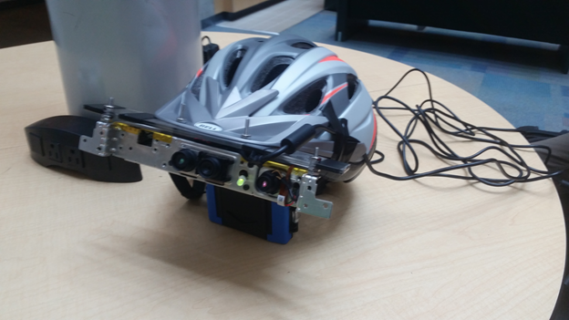
System Hardware
Use of Microsoft Kinect Rather than Intel
Stripping the Kinect
Powering the Prototype Through a Computer
12 Volt Power Adapter
Notes:
we debated between the Microsoft kinect and Intel’s realsense r200 ultimately with delays we could not use the intel camera
The Kinect was then stripped down to the minimal components but is still a larger prototype than expected
Along with stripping the Kinect we wanted to power the kinect through a USB, however the kinect uses 12V and a standard USB use 5V.
The system could be rewired with a additional power supply or standard wall outlet. There already exists an adapter for the old xbox 360 kinect that splits the wire components into a standard USB and separately power by a wall outlet.
we went this option to simplify our prototype.

Slide 4
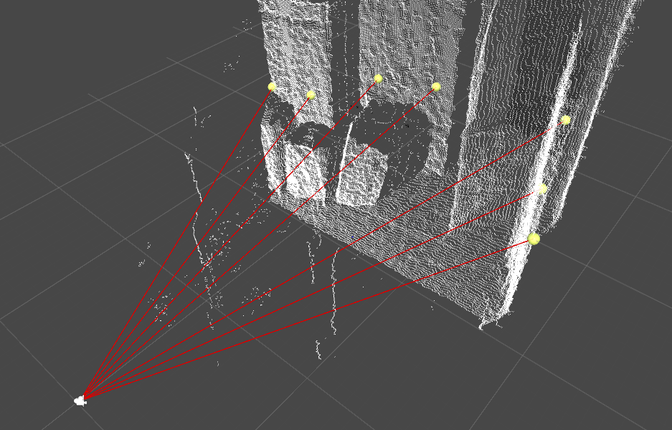
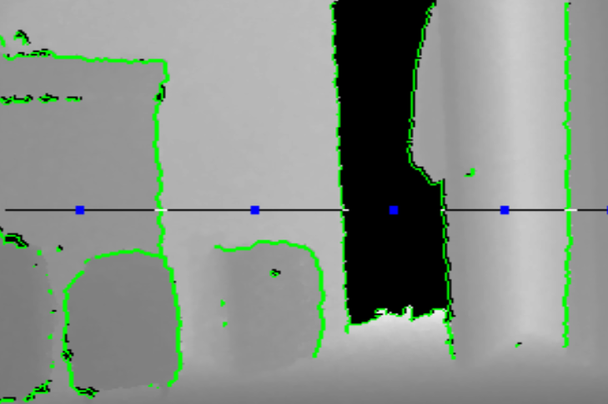
System Software
Binaural Audio Filtering
Depth Image Processing
Audio Signalling
Notes:
In terms of software, we have 3 main components that we have been working on. The first is the binaural audio filtering which allows us to generate the spatialized audio that will be used in our audio cues for identifying objects. There wasn’t a whole lot of work to be done on this end as this is something we had already researched and prototyped last year in 399. The second part is the depth image processing which has taken up the most of our software development bandwidth. Given that our intention is to have the system act as a vision aid, we want to make sure we get this right.
Up on the slides, you can see some of the ways we’ve been trying to express the depth data that we get from the depth camera. One method we have as shown on the left is to send out a spray of rays that will emit a unique tone from each object they hit. Another method which we have shown in the second picture is to identify the boundaries of the surfaces in the scene place an audio cue at the center of where each surface has been detected.
The audio signalling aspect of the system is by far the most experimental portion of this project, and as a result, is also the portion with the most risk. We expect that we’ll be working right up to the deadline on optimizing this.

Slide 5
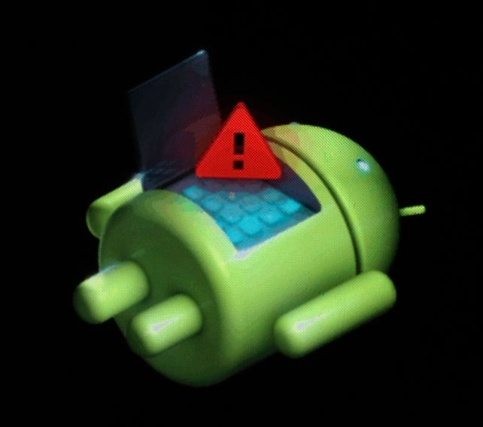
Project Changes
Mobile development - discontinued
Relaxed hardware prototype constraints
Shift in focus to core signalling model

Slide 6
Going Forward
User Testing!
System Refinement
Webpage Development

